Slide 1
Software Requirements Engineering
By
Abid Ali
BS Software Engineering
5th
Lecture #13

Slide 2
Agenda
Planning elicitation on your project. . . . . . . . . .
Preparing for elicitation. . . . . . . . . .
Performing elicitation activities. . . .
Following up after elicitation. . . . . .
Organizing and sharing the notes. . . . . . . .
Documenting open issues. . . . . . . . . . . . . . . . .

Slide 3
Planning elicitation on your project
Early in a project, the business analyst should plan the project’s approach to requirements elicitation.
Even a simple plan of action increases the chance of success and sets realistic expectations for the stakeholders.
Your plan should address the following items:

Slide 4
Cont..
Elicitation objectives:
Plan the elicitation objectives for the entire project and the objectives for each planned elicitation activity.
Elicitation strategy and planned techniques:
Decide which techniques to use with different stakeholder groups.
You might use some combination of questionnaires, workshops, customer visits, individual interviews, and other techniques, depending on the access you have to stakeholders, time constraints, and your knowledge of the existing system.

Slide 5
Cont..
Schedule and resource estimates:
Identify both customer and development participants for the various elicitation activities, along with estimates of the effort and calendar time required.
You might only be able to identify the user classes and not specific individuals up front, but that will allow managers to begin planning for upcoming resource needs

Slide 6
Cont..
Documents and systems needed for independent elicitation:
If you are conducting document, system interface, or user interface analysis, identify the materials needed to ensure that you have them when you need them.
Expected products of elicitation efforts:
Knowing you are going to create a list of use cases, an SRS, an analysis of questionnaire results, or quality attribute specifications helps ensure that you target the right stakeholders, topics, and details during elicitation.

Slide 7
Cont..
Elicitation risks Identify factors that could impede your ability to complete the elicitation activities as intended, estimate the severity of each risk, and decide how you can mitigate or control it.

Slide 8
Cont..
Figure 7-3 suggests the elicitation techniques that are most likely to be useful for various types of projects.
Select the row or rows that represent characteristics of your project and read to the right to see which elicitation techniques are most likely to be helpful (marked with an X).
For instance, if you’re developing a new application, you’re likely to get the best results with a combination of stakeholder interviews, workshops, and system interface analysis.

Slide 9
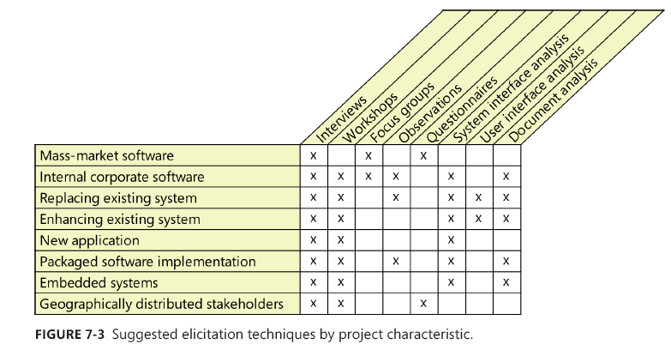
Cont..

Slide 10
Preparing for elicitation
Facilitated elicitation sessions require preparation to make the best use of everyone’s time. The larger the group participating in the session, the more important preparation is. Figure 7-4 highlights the activities to prepare for a single requirements elicitation session.

Slide 11
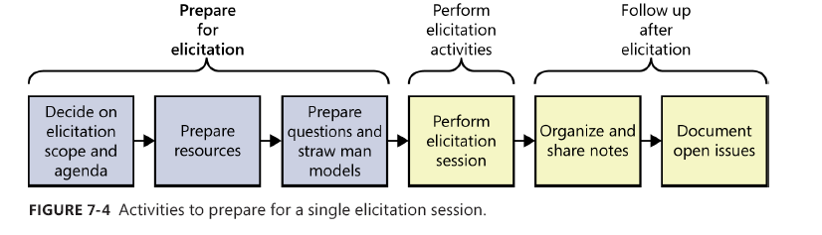
Cont..

Slide 12
Cont..
Plan session scope and agenda:
Decide on the scope of the elicitation session, taking into account how much time is available.
You might define the session scope by using a set of topics or questions, or you might list a specific set of process flows or use cases to be explored.
Prepare resources:
Schedule the physical resources needed, such as rooms, projectors, teleconference numbers, and videoconferencing equipment.
Also, schedule the participants, being sensitive to time zone differences if you are not all in the same location

Slide 13
Cont..
Learn about the stakeholders
Identify the relevant stakeholders for the session (see Chapter 6, “Finding the voice of the user”). Learn about the stakeholders’ cultural and regional preferences for meetings.
Prepare questions
Go into every facilitated elicitation session with a set of prepared questions. Use areas of uncertainty in straw man models (described in the next section) as a source of questions.
If you are preparing for an interview or workshop, use results from other elicitation techniques to identify unresolved questions.
There are many sources of suggested questions for elicitation (Wiegers 2006; Miller 2009).

Slide 14
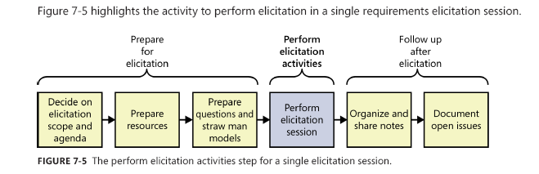
Performing elicitation activities

Slide 15
Cont..
Executing the elicitation activity itself is relatively obvious—if you are interviewing, you talk to people; if you are performing document analysis, you read the document.
However, when facilitating an elicitation activity, the following tips might be useful.

Slide 16
Cont..
Educate stakeholders
Teach your stakeholders about your elicitation approach and why you chose it.
Explain the exploration techniques you’ll be using, such as use cases or process flows, and how they can help stakeholders provide better requirements.
Also describe how you will capture their information and send them materials for review after the session.

Slide 17
Cont..
Take good notes
Assign someone who isn’t actively participating in the discussion to be the scribe, responsible for taking accurate notes.
Session notes should contain an attendee list, invitees who did not attend, decisions made, actions to be taken and who is responsible for each, outstanding issues, and the high points of key discussions.

Slide 18
Cont..
Exploit the physical space
Most rooms have four walls, so use them during facilitation to draw diagrams or create lists. If there aren’t whiteboards available, attach big sheets of paper to the walls.
Have sticky notes and markers available. Invite other participants to get up and contribute to the wall as well; moving around helps to keep people engaged.
Gottesdiener (2002) refers to this technique as the “Wall of Wonder” collaboration pattern.
If there are existing artifacts to look at (such as straw man models, existing requirements, or existing systems), project them on the wall.

Slide 19
Following up after elicitation
After each elicitation activity is complete, there’s still a lot to do.
You need to organize and share your notes, document open issues, and classify the newly gathered information.
Figure 7-6 highlights the activities to follow up after a single requirements elicitation session.

Slide 20
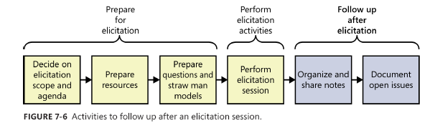
Cont..

Slide 21
Cont..
Organizing and sharing the notes:
If you led an interview or workshop, organizing your notes probably requires more effort than if you organized information as you encountered it during an independent elicitation activity.
Consolidate your input from multiple sources. Review and update your notes soon after the session is complete, while the content is still fresh in your mind.

Slide 22
Cont..
Documenting open issues:
During elicitation activities, you might have encountered items that need to be further explored at a later date or knowledge gaps you need to close.
Or you might have identified new questions while reviewing your notes.
Examine any parking lots from elicitation sessions for issues that are still open and record them in an issue-tracking tool.
For each issue, record any relevant notes related to resolving the issues, progress already made, an owner, and a due date.
Consider using the same issue-tracking tool that the development and testing teams use

Slide 23
The End
Thank You

